Slide 1

Tableau Visual Analysis
-- Mounika Voriganti

Slide 2
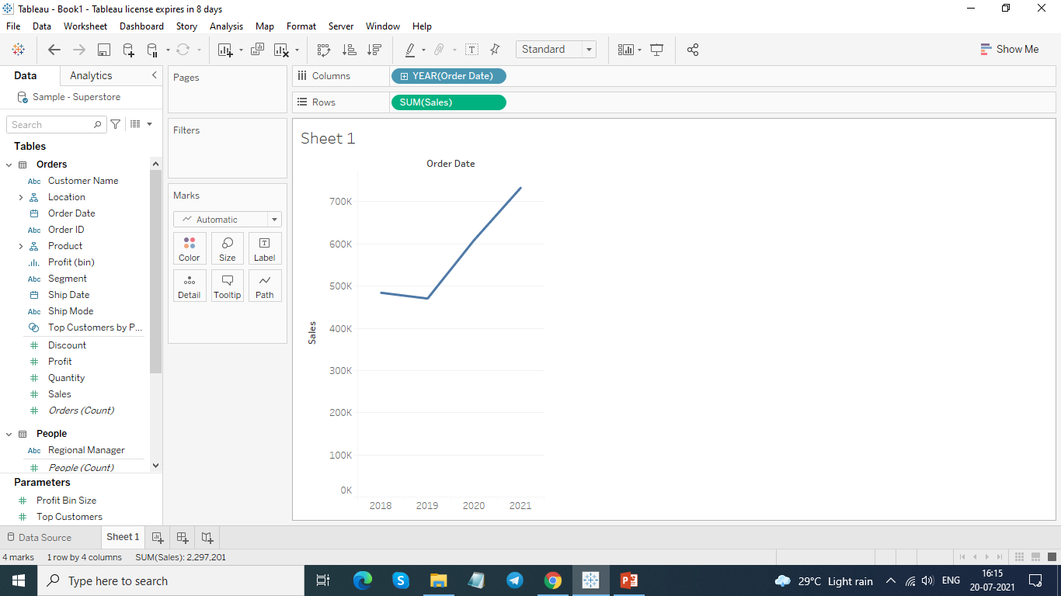
Find total aggregated sales for each year by order date.

Slide 3
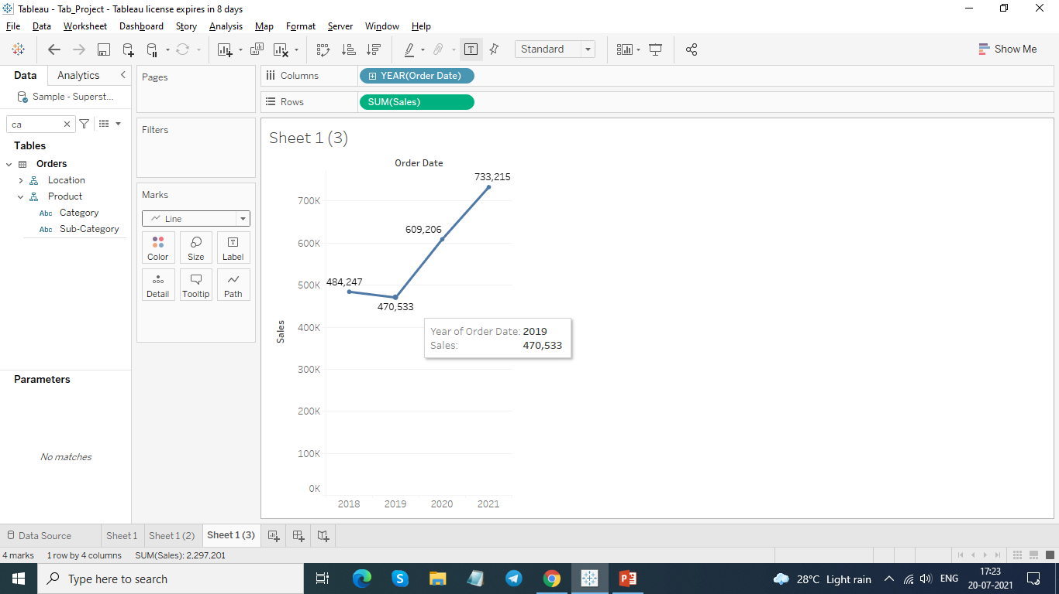
In which years sales was minimum and maximum
Maximum – 2021 [733,215]
Minimum – 2019 [470,533]

Slide 4
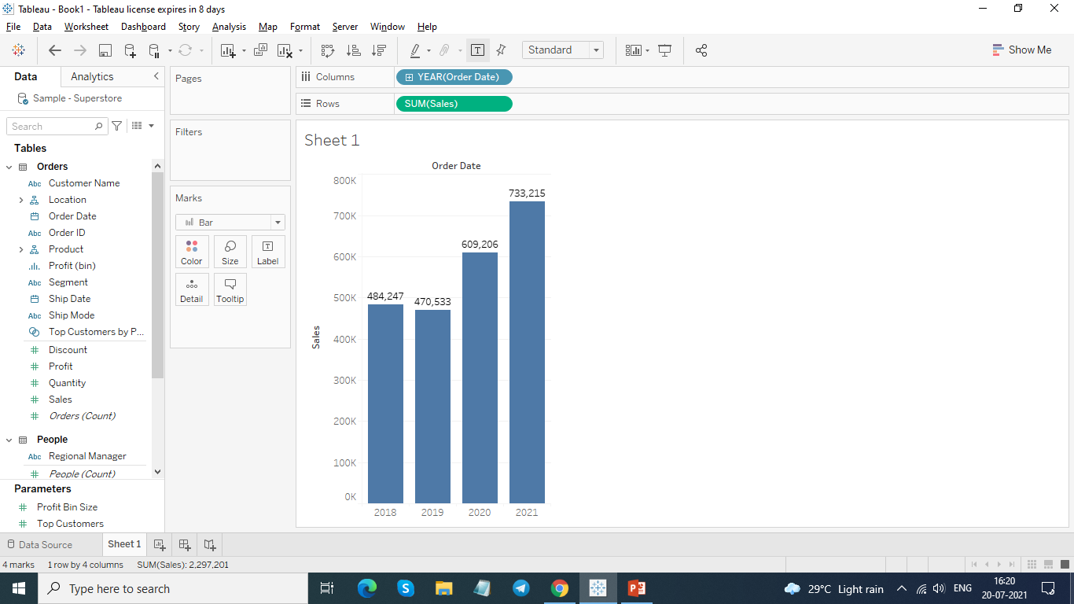
Find the highest sales and show the view in bar graph and label it.

Slide 5
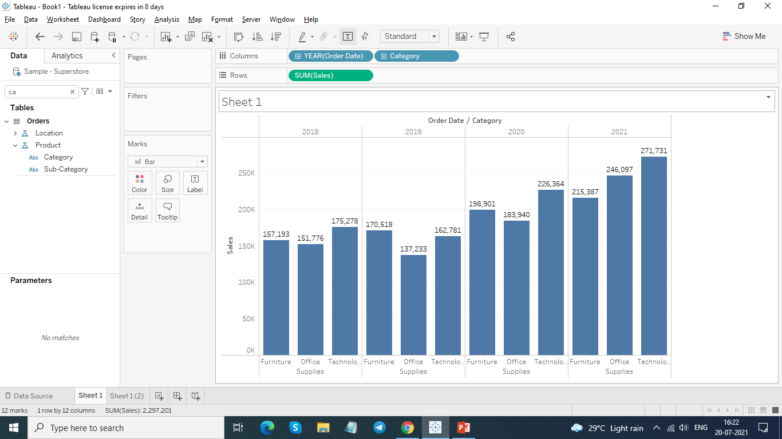
Find the category wise sales for every year.

Slide 6
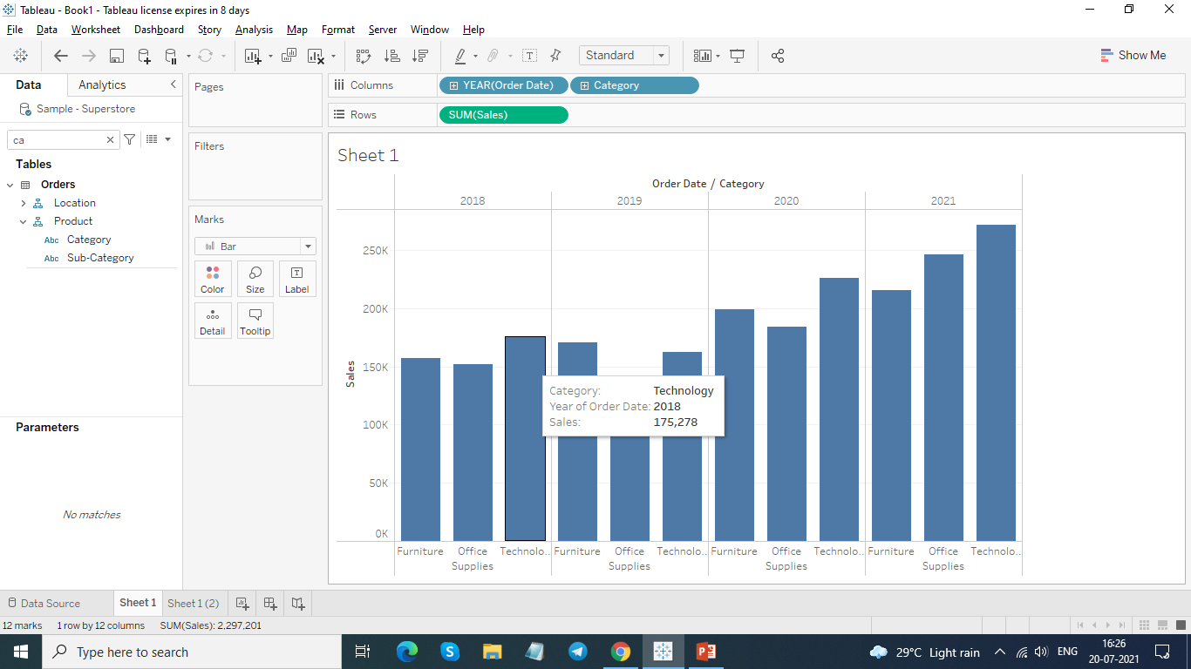
Check the tooltip for sales for every category.

Slide 7
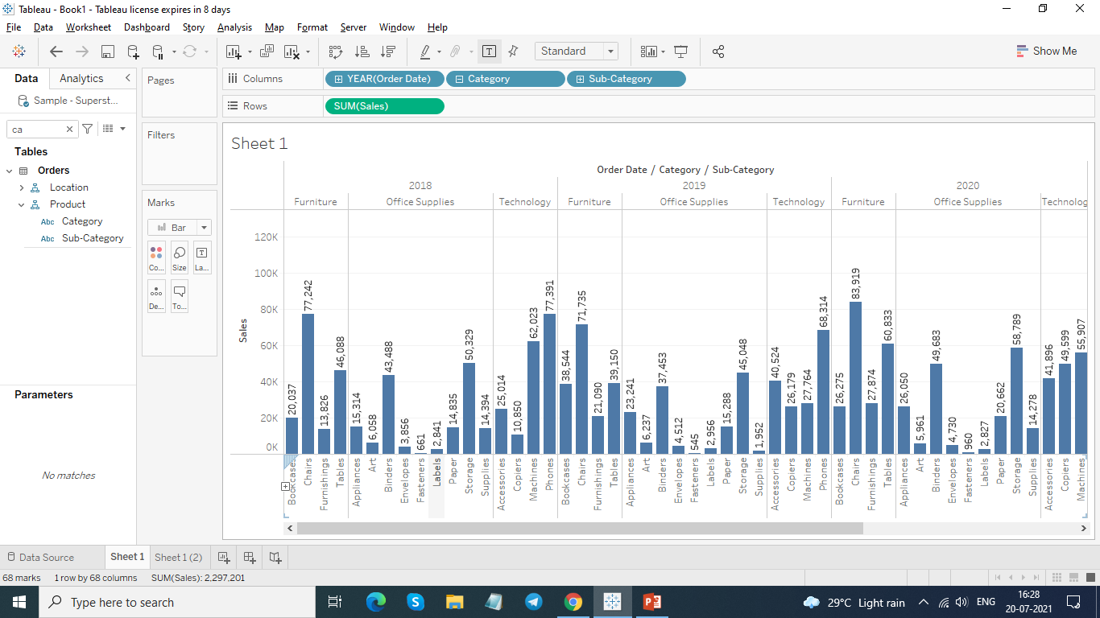
Display subcategory and find some insights from the view about max and min sales under every category.

Slide 8
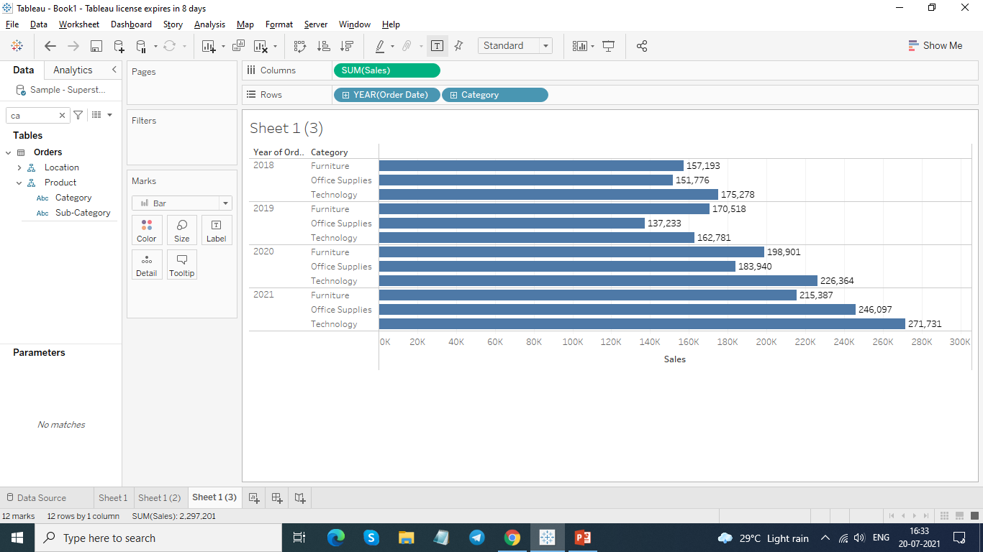
swap rows and columns using appropriate option and display the view horizontally.

Slide 9
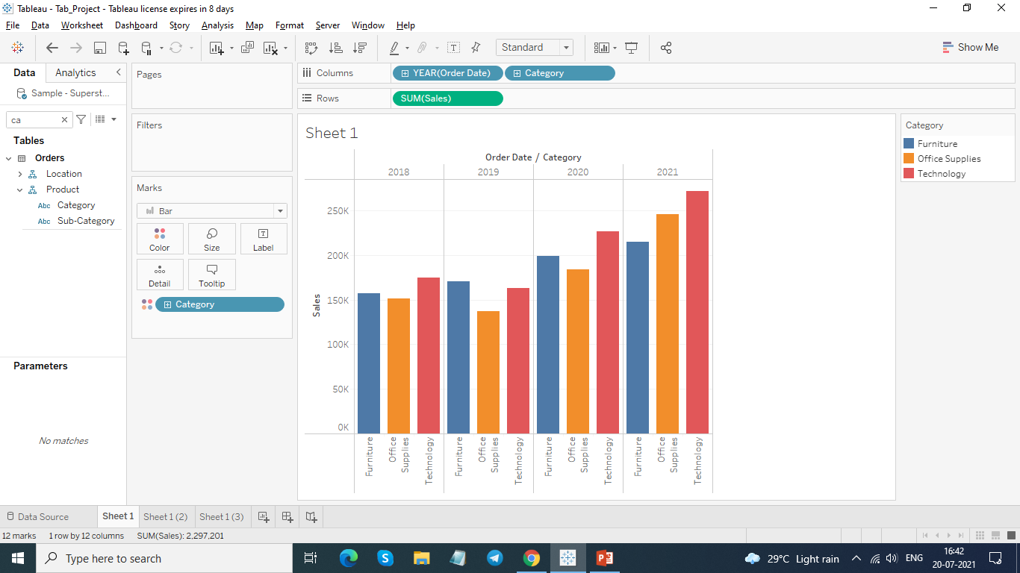
Represent your view using different color.

Slide 10
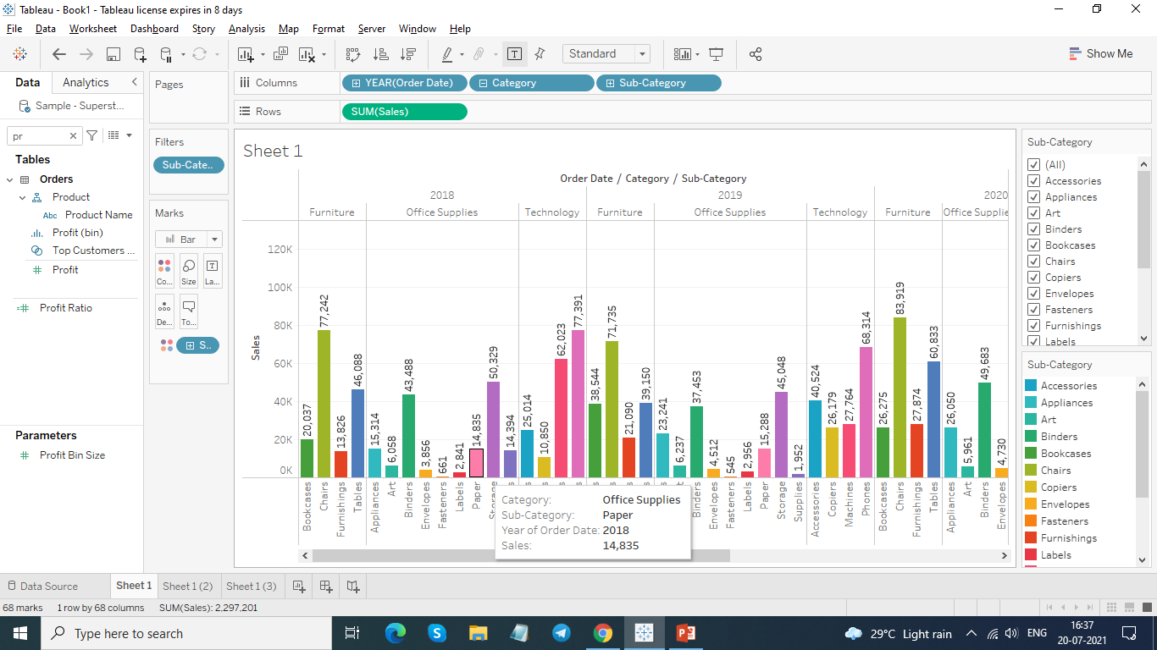
Use colour cart to show subcategory under every category.

Slide 11
Which category has highest sales in every year?
2018 – Technology
2019 – Furniture
2020 – Technology
2021 -- Technology

Slide 12
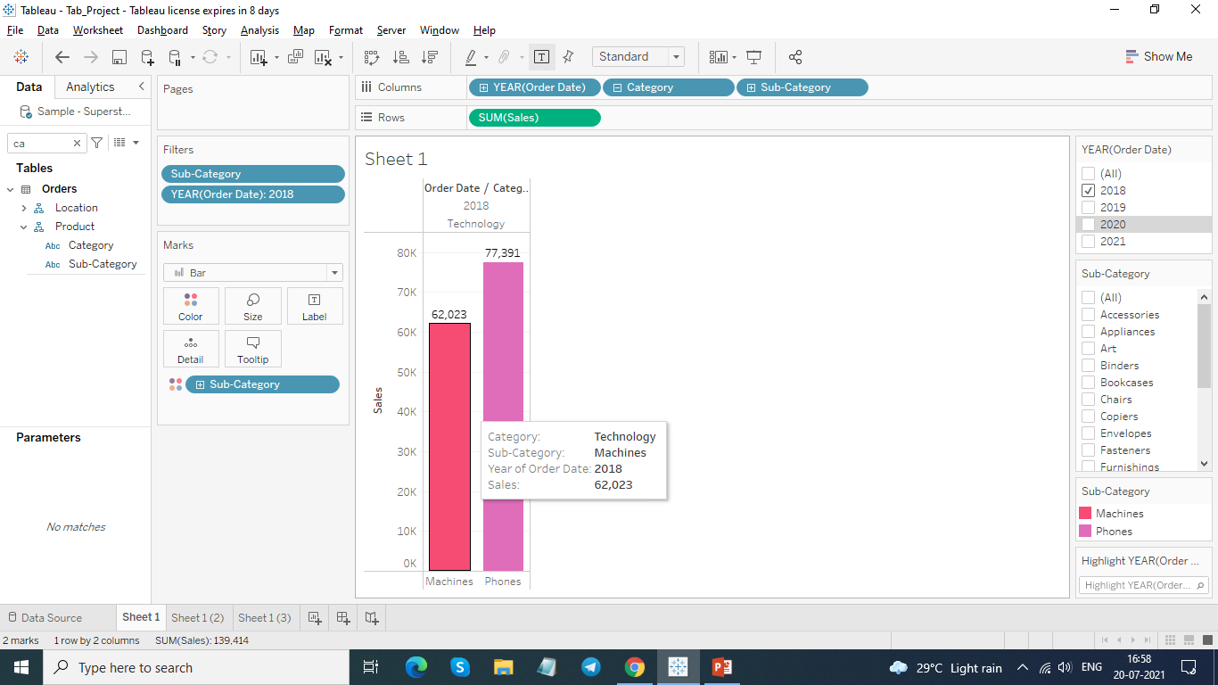
What is the total sales of machine and phones type subcategory in the year 2018.

Slide 13
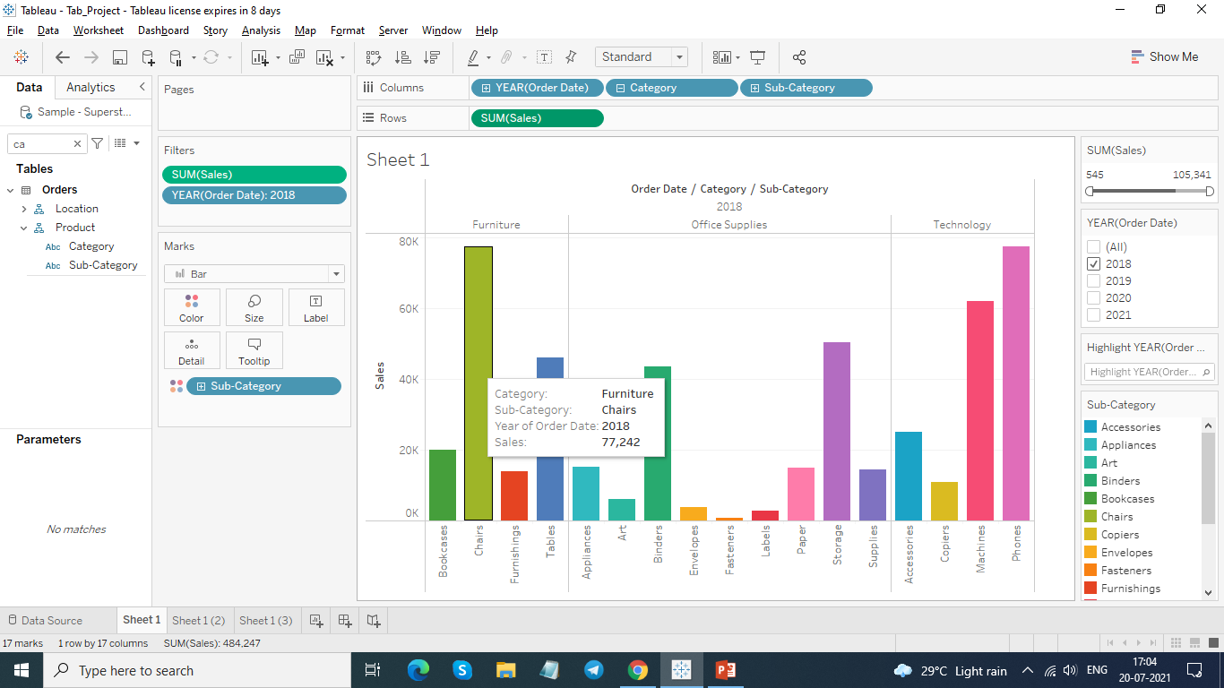
Which subcategory of furniture type category has highest sales in 2018. --- Chairs

Slide 14
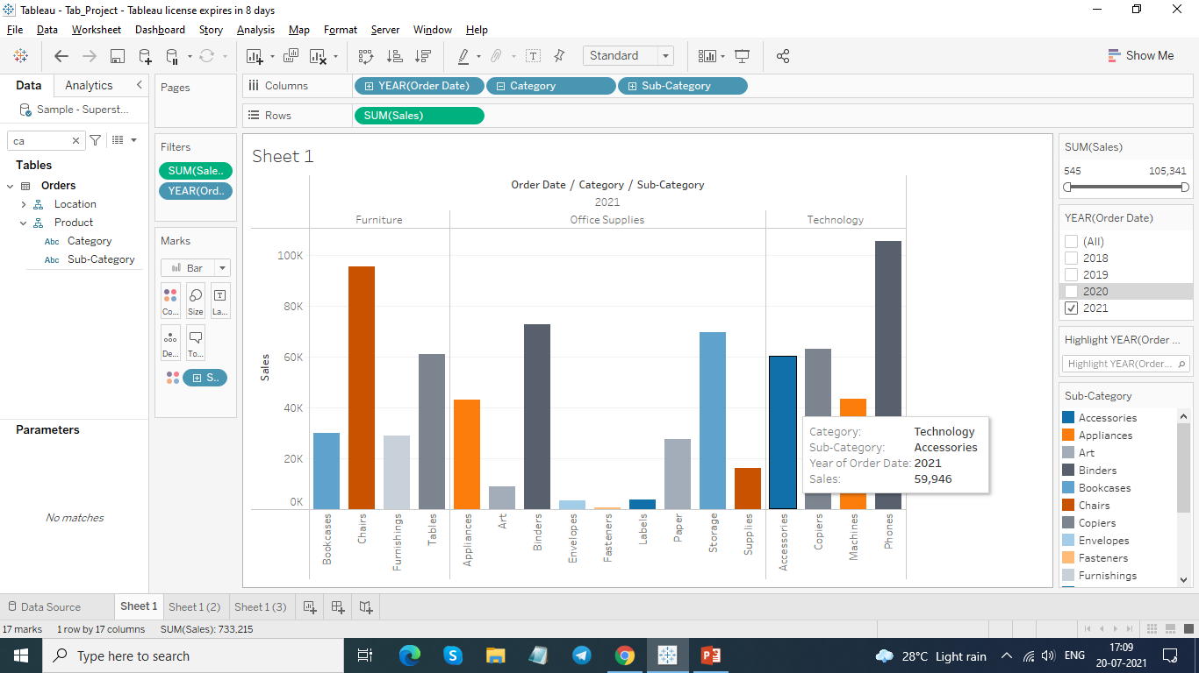
In the year 2021 which subcategory has highest sales under each category.
Furniture – Chair
Office Supplies – Binders
Technology -- Phones

Slide 15
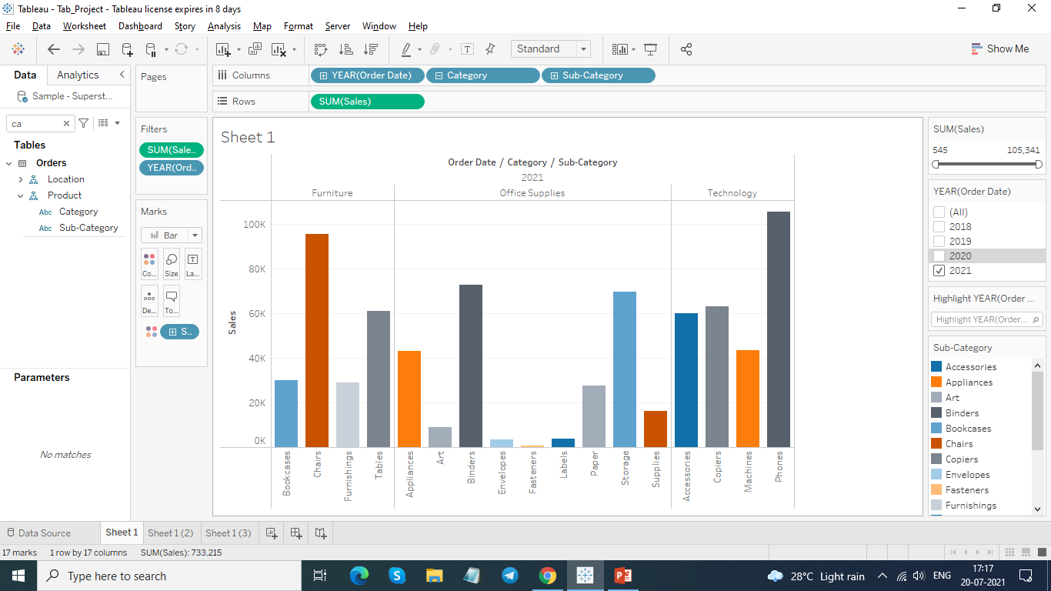
In the year 2021 which subcategory has lowest sales under each subcategory.
Furniture -- Furnishings
Office Supplies – Fasteners
Technology – Machines

Slide 16
Thank You

